Slide 1
PRINCIPLES OF FLIGHT
CHAPTER 4

Slide 2
THE OBJECTIVE
To understand how the various aerodynamic forces act on an airplane and to know how to control those forces for safe flight

Slide 3
WHERE TO START?
Gather up your resource texts, the PTS and the FAA reference books and AC’s
In this case the PHAK, with a few sprinkles from Aerodynamics for Naval Aviators, Kershner, and Dole
The best place to start is with definitions
From the PTS:
1. Airfoil design characteristics
2. Airplane stability and controllability
3. Turning tendency (torque effect)
4. Load factors in airplane design
5. Wingtip vortices and precautions to be taken

Slide 4
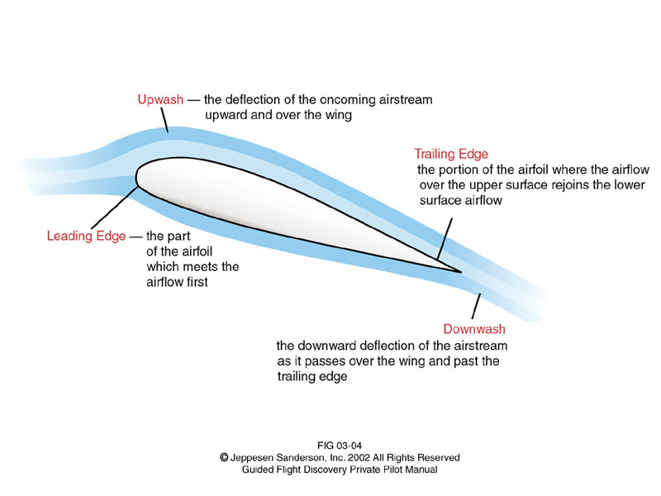
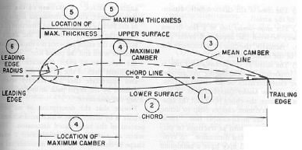
Terms And Definitions
Airfoil
Leading edge
Trailing edge
Camber
Chord line
Mean camber line
Relative wind
Angle of attack (alpha)
Angle of incidence

Slide 5
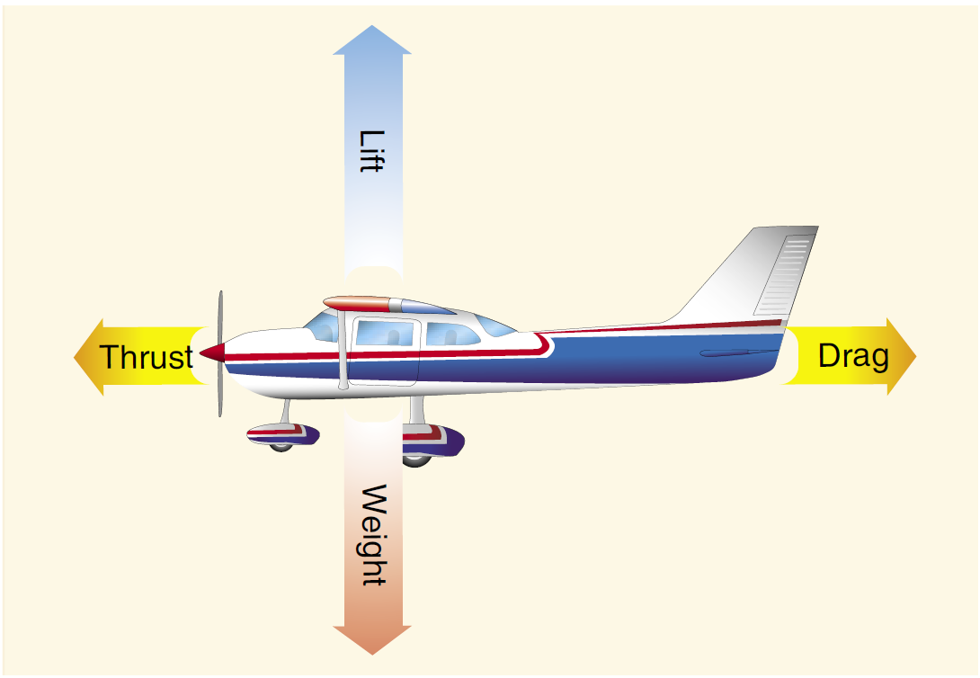
THE 4 FORCES
Lift
Weight
Thrust
Drag
The relationship of the forces
Take each and explain in the appropriate detail for the level of the student

Slide 6
Lift
Since a primary piece of lift generation revolves around air density, you’ll need to cover this, include
Standard atmosphere:
Temp. 15°C, 59°F
Pressure 2116psf, 14.7psi, 29.92Hg, 1013.2mb
Density .002377 slugs per cubic foot (the most important of the 3)
Density altitude is an important concept to cover here; include
Effects of pressure
Effects of temperature
Effects of humidity
Effects of elevation
If previously not covered hit:
Indicated, pressure, density, true and absolute altitudes
Indicated, calibrated, equivalent, and true airspeeds

Slide 7
LIFT
3 ways lift is created
1. Deflection - Newton's 3rd law
2. Downwash – Newton’s 3rd law
3. Bernoulli's principle
Positive pressure below
Negative pressure above
There are 3 concepts to lift generation
Conservation of momentum
Conservation of energy
Conservation of mass
Newton’s laws explain the conservation of momentum
Every action has an opposite and equal reaction
Bernoulli’s equation explains the conservation of energy
Static pressure + Dynamic pressure = Total pressure
Euler equations explain the conservation of mass
This is where it gets messy

Slide 8
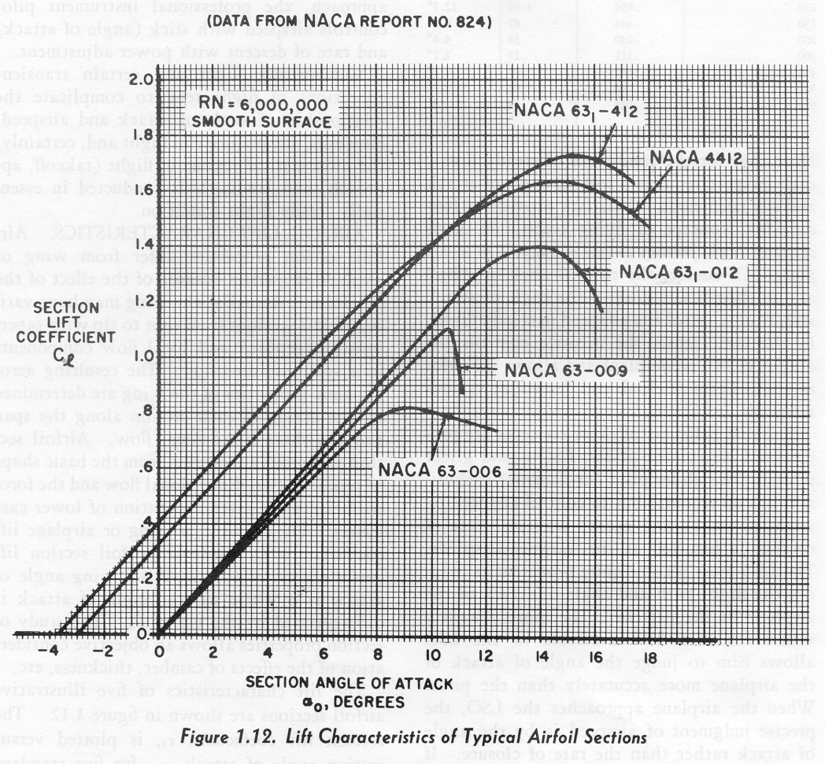
LIFT
1. Airstream velocity V (knots)
2. Air density ratio (sigma)
3. Airfoil planform area square feet
4. Profile shape of the airfoil
5. Viscosity of the air
6. Compressibility effects
7. Angle of attack (degrees)

Slide 9
WEIGHT
Weight acts vertically through the center of gravity (define CG)
Weight also acts in component vectors along climbs and descents

Slide 10
THRUST
Thrust moves the aircraft forward
In order to do this is must produce a force greater than drag
Thrust is what offsets the component of weight in a climb
A increase in thrust will increase V and cause a lower alpha
Since the opposite is also true, coordination between alpha and thrust must occur to maintain level flight

Slide 11
DRAG
Drag is the force that resists movement through the air
There are 2 types:
Induced
Parasite (FLIPS)
Form
leakage
Interference
Profile
Skin friction
L/Dmax

Slide 12
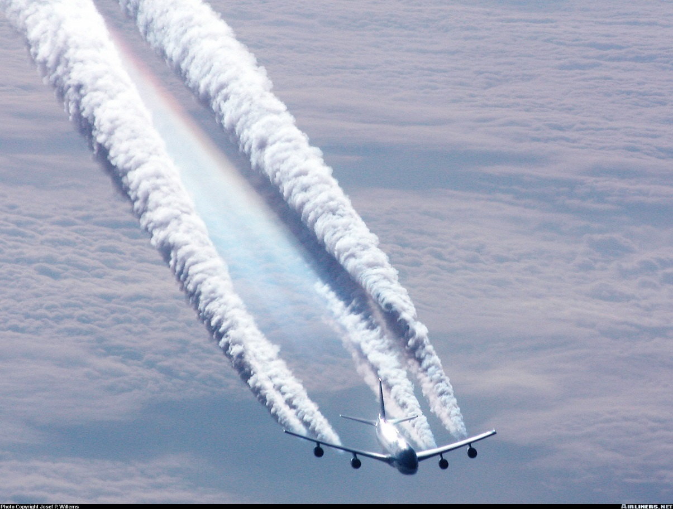
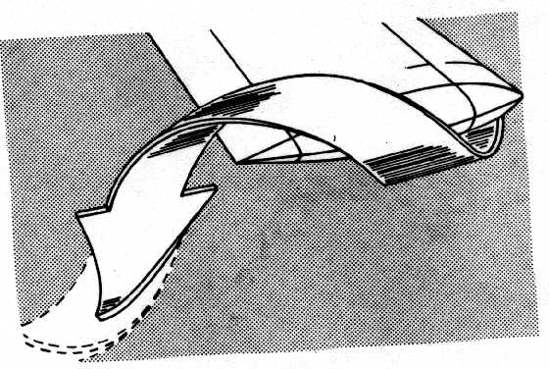
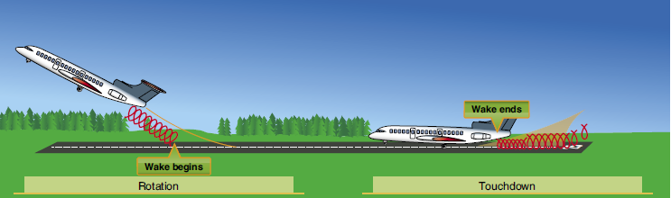
WINGTIP VORTICES
Theory
How are they generated (pressure differential)
Induced drag connection
Peak Tangential speed at 300 fps
Heavy clean slow
Vortex Behavior and Avoidance
Levels off 800 to 1000 feet below
Sink at a rate of several hundred feet minute
No wind vortex moves outward at 2 to 3 kts
A light crosswind 1 to 5 kts causes upwind vortex to stay on the runway
Turbulence and higher wind can cause early break up

Slide 13
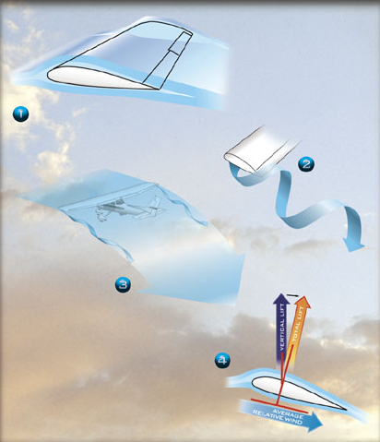
Ground Effect
Ground effect is the reduction of induced drag experienced when flying 1 wing span or less above the ground
There is an alteration of upwash, downwash and wingtip vortices
The ground reduces the vertical component of airflow (downwash)
There is a reduction of wingtip vortices due to a reduction of spanwise flow
This in turn reduces induced drag
At 1 wing span drag is reduced 1.4%
At ¼ span drag is reduced 23.5%
At 1/10 span drag is reduced 47.6%
This is why we use ½ span in our pre-takeoff brief
Wing span on the F-33A is 33’6”

Slide 14
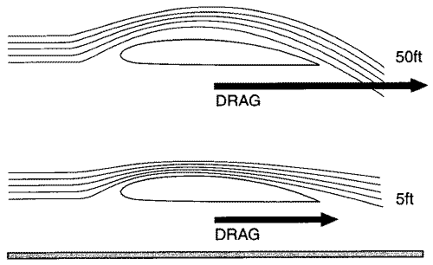
Ground effect
Pitching moments develop upward for the aircraft leaving ground effect and may cause an increase in angle of attack such that the corresponding increase in drag may cause the aircraft to settle.
The pitch up and down moments are experienced entering and leaving ground effect
Level flight in ground effect results in a significant pitch up requiring a substantial force on the yoke to keep the nose down
There is also a change in the effective angle of attack. Because of the altered downwash, an angle of attack decrease for the same CL is the result
Pitching moments develop downward for an aircraft entering ground effect because of the wings downwash not being able to help the tail generate lift downward.

Slide 15
Ground Effect Summary
On entering ground effect:
Induced drag is decreased
Nose-down pitching moments occur
Airspeed may indicate slow
On leaving ground effect
Induced drag is increased
Nose-up pitching moments occur
Airspeed may indicate higher
Manufacture’s design CG range is determined to a large extent based on the pitch moments developed entering and leaving ground effect

Slide 16
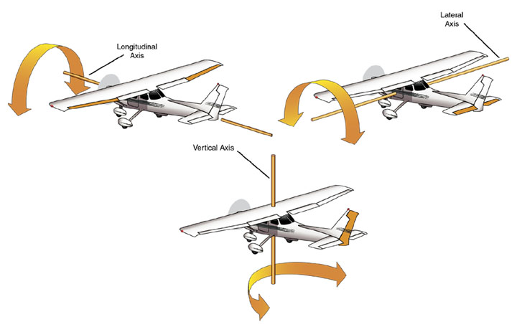
Axes of Control
Longitudinal axis runs nose to tail
Ailerons control bank about the longitudinal axis
Vertical axis runs through the roof and belly usually through the cabin area
Rudder controls yaw about the vertical axis
Lateral axis runs wingtip to wingtip
Elevator controls pitch about the lateral axis
Understanding of the axes is critical to our next topic – stability

Slide 17
Stability
Stability is generally discussed with reference to the 3 axis
Longitudinal stability which is pitch stability
Lateral stability which is roll stability
Vertical stability which is yaw stability
Stability is further categorized
Positively stable – resists any displacement
Negatively stable – favors displacement
Neutrally stable – neither resistant or favoring displacement

Slide 18
Aircraft Design Characteristics
Engineers design in specific control characteristics based on the job the aircraft needs to do
Training aircraft generally are quick to respond to inputs
Transport category aircraft are usually slower to respond and are heavier on the controls
Stability affects 2 areas significantly:
Maneuverability
Controllability

Slide 19
Maneuverability & Controllability
Controllability:
The capability of the aircraft to respond to the pilot’s inputs
Especially with regard to flightpath and attitude
Maneuverability:
The quality of an aircraft that permits it to be maneuvered easily
Also the ability to withstand the stresses imposed by those maneuvers
It is governed by weight, inertia, size and location of flight controls, structural strength, and powerplant

Slide 20
Stability
The flightpaths and attitudes an aircraft flies are limited by
The aerodynamic characteristics
Thrust
Structural limitations
If the maximum utility is desired, it has to be able to be safely controllable to its limits without exceeding the pilot’s strength
There are two types of stability
Static
Dynamic

Slide 21
Static Stability
Is the initial tendency of an aircraft to move, once it has been displaced from its equilibrium position
This type of stability has three subtypes:
Positive static stability is indicated by initial movement back to the original position
Neutral static stability is indicated by initial movement to stay in the new position
Negative static stability is indicated by initial movement away from the original position

Slide 22
Dynamic stability
Dynamic stability refers to the aircraft response over time when disturbed from a given AOA, slip, or bank.
This type of stability also has three subtypes:
Positive dynamic stability—over time, the motion of the displaced object decreases in amplitude and, because it is positive, the object displaced returns toward the equilibrium state.
Neutral dynamic stability—once displaced, the displaced object neither decreases nor increases in amplitude. A worn automobile shock absorber exhibits this tendency.
Negative dynamic stability—over time, the motion of the displaced object increases and becomes more divergent.

Slide 23
Dynamic Stability
The oscillations made during the progression are called periodic motion
Amplitude is the measurement of the movement of each oscillatory period
Aperiodic motion is non-timed motion
The airplane may have positive static stability but that does not mean it has positive dynamic stability in every circumstance
Outside forces may act in such a way as to increase the amplitude

Slide 24
Static and Dynamic stability
If the airplane has positive static stability normally an oscillation will exist
However, if acted on by an outside force, the dynamic stability may be neutral or even negative
The oscillations may stay the same or become greater
This may happen to the point of structural failure
If the airplane has neutral or negative static stability no oscillation will exist
The movement may be to a new direction or diverge from the original direction at a faster and faster rate

Slide 25
Stability types
We can categorize stability along the 3 axis:
Longitudinal or pitch stability
Pitching occurs about the lateral axis
Lateral or roll stability
Rolling occurs about the longitudinal axis
Vertical or yaw stability
Yawing occurs about the vertical axis

Slide 26
Longitudinal Stability
Longitudinal stability is the quality that makes a plane stable about it’s lateral axis
A plane without this may pitch into a dive or climb and into a stall
Static longitudinal stability is dependent on 3 major factors:
Location of the wing with respect to the cg
Location of the tail with respect to the cg
Area or size of the tail surface

Slide 27
Longitudinal Stability
The center of pressure moves aft with a decrease in alpha
The center of pressure moves forward with an increase in alpha
This means that a pitch up moment causes a unstable condition because lift is increasing and moving forward at the same time
This causes the alpha to further increase
In order to counter this problem, the cg must be forward of the center of lift

Slide 28
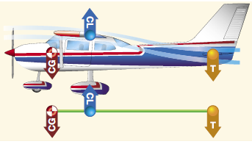
Longitudinal Stability
Longitudinal stability is dependent upon 3 factors:
Location of the center of lift to the CG
Location of the tail to the CG
Area of the tail
To make this condition stable, tail down force is needed
There are two forces in play here:
α is set to a negative value on the tail
Downwash from the main wing
The faster the plane flies the more tail down force from downwash (except for T tails)
On elevators the manufacturer sets the tail down force to optimum for cruise speed and power settings
On stabilators, camber of the airfoil and trim is used to achieve the same result
On average a stabilator only needs to deflect about half the amount of an elevator

Slide 29
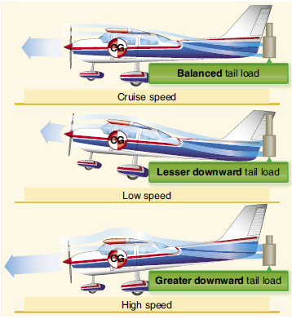
Longitudinal Stability
As the speed decreases the dynamic pressure is decreased on the tail allowing the nose to pitch down
In addition the downwash is also reduced causing a lesser downward force on the tail
This places the plane in a nose low pitch allowing speed to increase
This in turn causes the nose to pitch up but not as far this time (in positively dynamically stable aircraft)
This oscillation continues until it levels out
A power change has the same effect

Slide 30
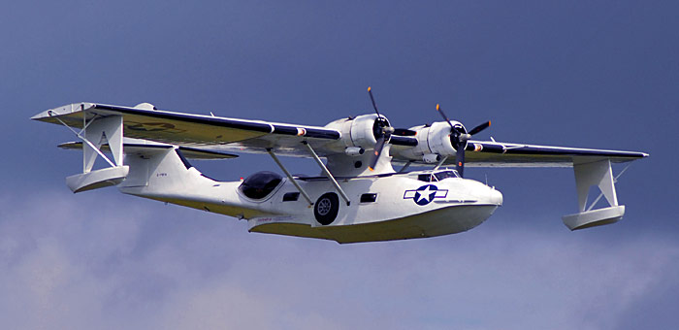
Longitudinal stability
Power is considered to have a destabilizing effect on stability
Generally addition of power causes the pitch to increase
This all depends on the thrust line built into the aircraft design, however
Below the cg, addition of power will give a pitch up
Through the cg, addition of power will give no pitch change (other than downwash on the tail discussed earlier)
Above the cg, addition of power will cause a pitch down

Slide 31
Longitudinal stability
Loading effects on longitudinal stability
With an aft cg, over-rotation may become a real problem
Higher cruise speed
Lower stall speed
Less stable
With a forward cg, the plane may be so stable as to resist any rotation until a very high airspeed is reached
Lower cruise speed
Higher stall speed
More stable

Slide 32
Lateral Stability and Control
Lateral stability is the stability displayed about the longitudinal axis of the airplane or specifically the stability in the roll.
There are 4 main design factors that make a plane laterally stable:
Dihedral
Sweepback
Keel effect
Weight distribution

Slide 33
Lateral Stability
The different thing about Lateral stability is that there is really no force in a roll that will cause the airplane to right itself
There is really no aerodynamic force created in rolling that tends to restore the wings to level flight
In addition there is no force that will continue the roll once it has begun
Most airplanes are neutrally stable in the roll
Overbanking tendency in a turn

Slide 34
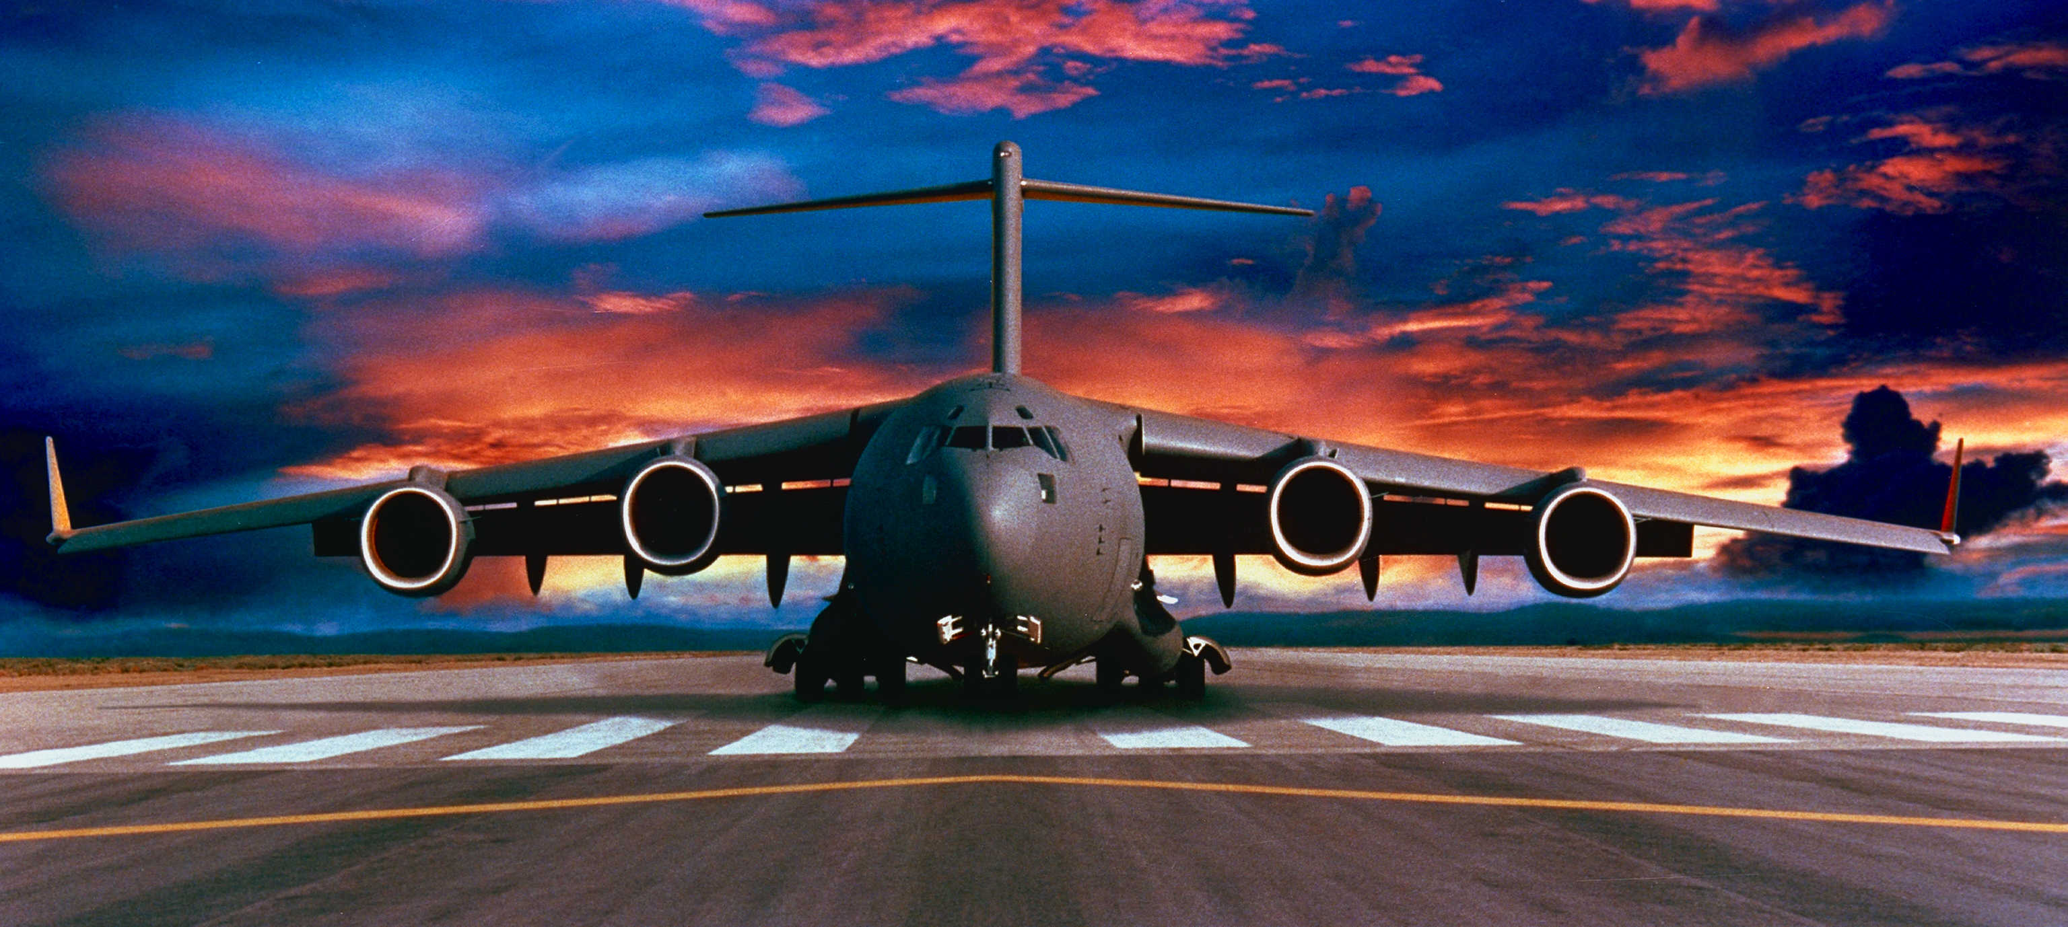
Dihedral or Anhedral
Dihedral is a stabilizing design, whereas Anhedral is a destabilizing design.
The stabilizing effect of dihedral occurs when a sideslip is set up as the result of turbulence or gust displacing the plane.

Slide 35
Dihedral
The side slip results in the downward wing having a greater angle of attack than the upward wing. The extra lift then rights the airplane.
The most common way to produce lateral stability is to use dihedral
Manufactures build in a 1 to 3 degree angle

Slide 36
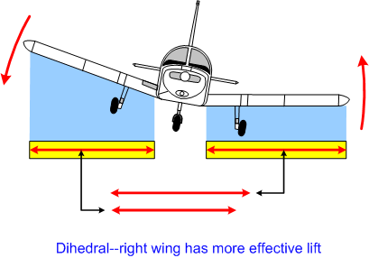
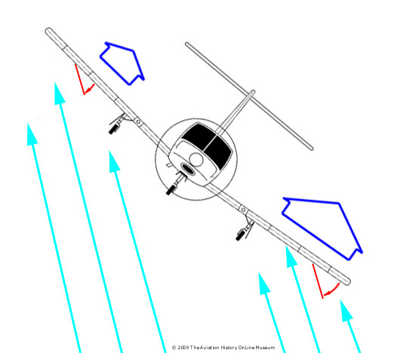
Dihedral
Dihedral involves a balance of lift created by each wing
If a gust causes roll, the aircraft will sideslip in the direction of the bank
Since the wings have dihedral the air strikes the lower wing at a much greater α
This causes more lift to be generated on the lowered wing making it rise
Once level the lift is equal again

Slide 37
Dihedral How Does It Work?
As you can see in this exaggerated diagram, the sideslip that sets up causes an increase in α
There is a change in the relative wind due to the slip
The lowered wing has a higher α due to the relative wind changing from directly 90 degrees to an angle off the wing tip
In addition the lowered wing has a greater vertical lift component
The raised wing has a greater horizontal lift component
This causes the imbalance in lift between the two wings
sideslip

Slide 38
Dihedral
If we look at the force vectors for a wing with dihedral we see that some of the lift the wing generates is tilted into the horizontal
This horizontal vector requires more lift from the wing than if it had no dihedral
This concept however is slight, the main reason dihedral works is due to the sideslip and increase in α
There are some penalties that go along with too much dihedral:
Less vertical component of lift
More drag (higher α to make up for loss of lift)
More aileron force to roll

Slide 39
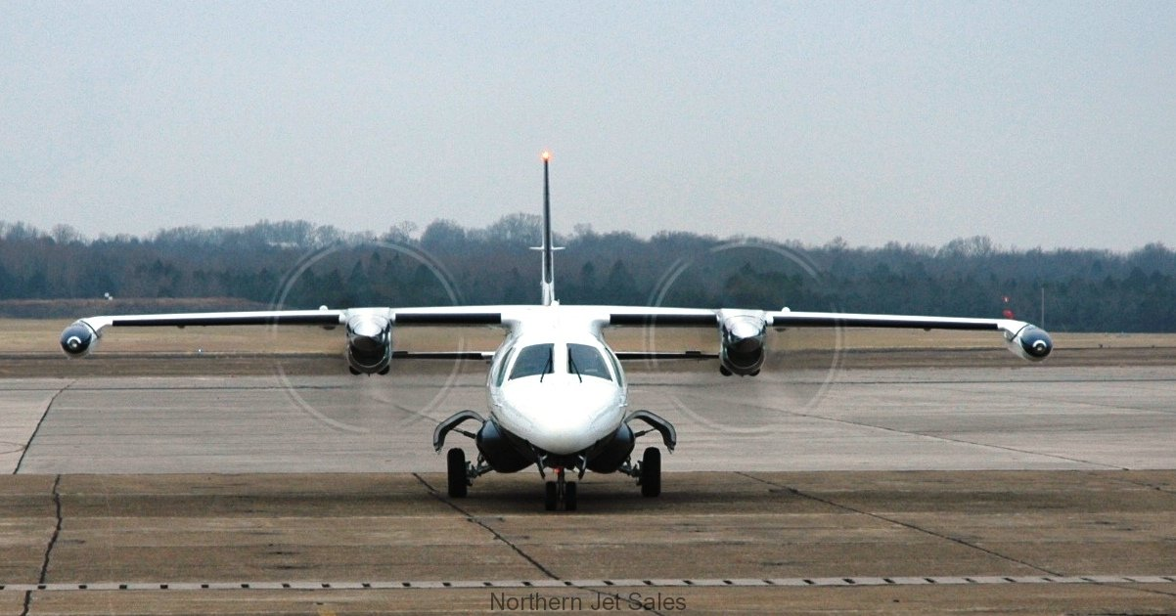
Wing position
Pendulum effect:
A high wing sets up a pendulum type of situation
This can result in the equivalent of a 1 to 3 degree dihedral.
So not as much dihedral is needed.
In some planes, negative dihedral is needed.
The low wing however the reverse is true.
Still other airplanes have both dihedral and anhedral
Keel effect:
A greater portion of the keel is above and behind the cg
When a slip occurs airflow pressure against the upper portion of the keel rolls the wings back to level
Notes:
Mitsubishi MU2

Slide 40
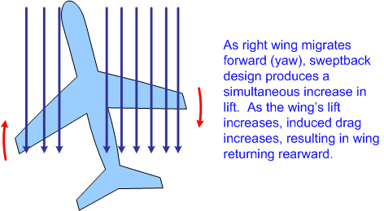
Wing Sweepback
When a side slip is set up in a sweepback wing, the upwind side wing will have a greater angle of attack because of the more favorable relative wind
The leading edge of the forward moving wing has a more favorable perpendicular angle to the relative wind
This caused more lift and thus more drag
Bringing the nose back to the original position

Slide 41
Yaw stability
Directional stability is mostly influenced by the vertical structures
In order for positive stability to result, more surface area must be behind the cg than ahead
When displaced the aircraft is still moving in the same direction with the longitudinal axis offset
This results in a momentary skid which is corrected by more force on the side of the plane in the direction of the skid
This force causes the plane to return, however a new heading will emerge
So a yaw force will always require a course correction from the pilot

Slide 42
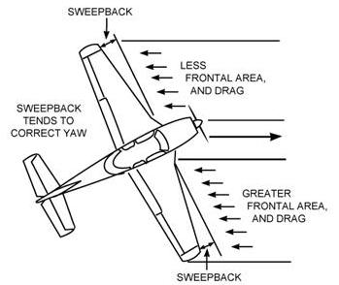
Yaw stability
Sweepback may be employed to enhance yaw stability
Wing drag increases on the forward moving wing which results in the nose yawing back to the original position
Dutch roll may be encountered when quickly depressing the rudder pedal and releasing
As the plane yaws, more lift is produced on the forward moving wing which causes roll and drag
As the drag pulls that wing back the other wing now moves forward creating more lift and again roll
This may continue until structural failure results

Slide 43
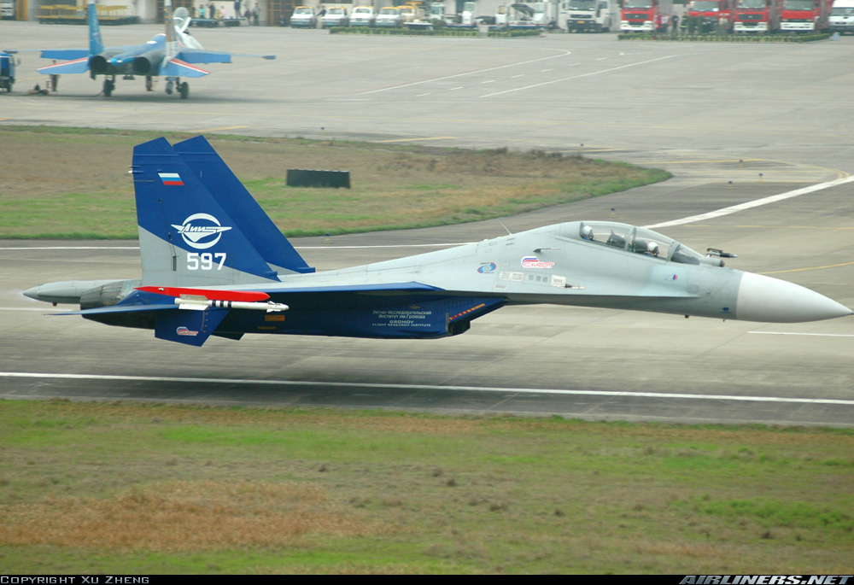
Directional Stability
The degree of directional stability is proportional to the size of the vertical stabilizer and the distance from the CG
Increase either or both and an increase in directional stability will result

Slide 44
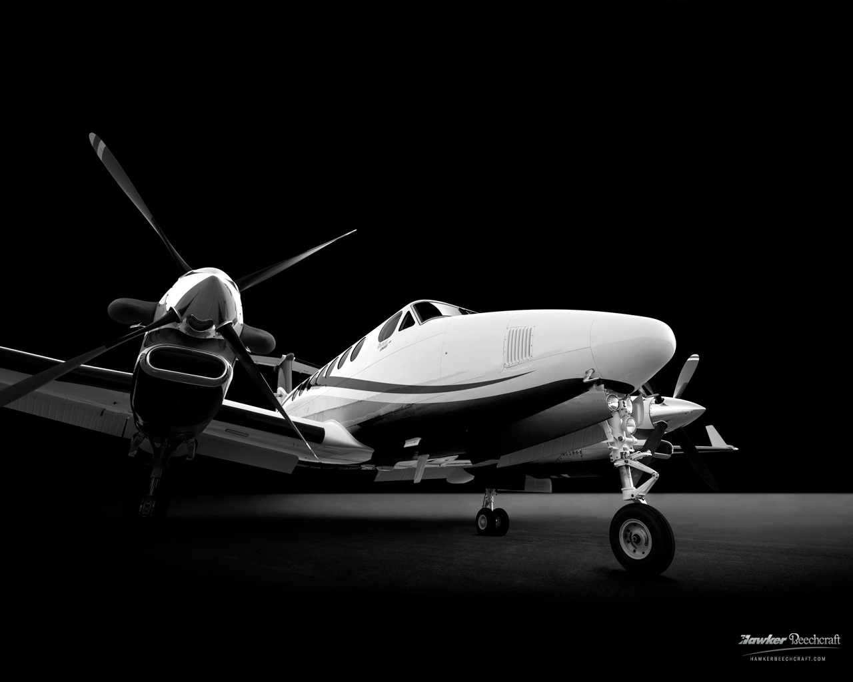
Directional-Lateral Coupling
Dutch roll is an example of directional – lateral coupling
The nose of the aircraft makes a figure 8 as the aircraft simultaneously rolls and yaws
This occurs most often in swept back wing planforms where there is a dissymmetry of lift usually caused by a gust
One of the more common examples of this is Adverse Yaw
Because the yaw is produced in the opposite direction of the turn it is referred to as adverse
When rolling into a turn, the upward wing's lift vector is tilted aft because of the change in the relative wind components being up and parallel to the flight path

Slide 45
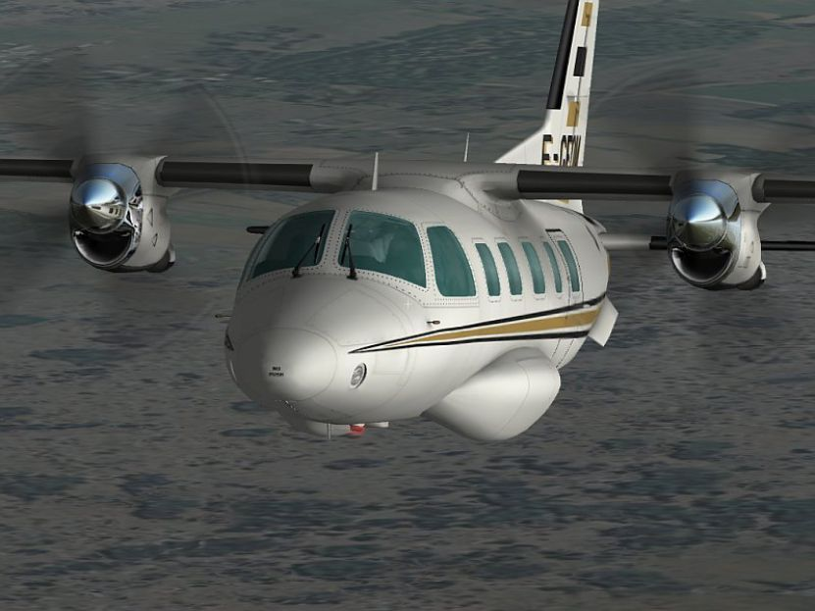
Adverse Yaw
The downward wing's lift vector is tilted forward because of the change in relative wind components being down and parallel to the flight path.
These two forces oppose the turn entry and cause adverse yaw.
Aileron drag is another common cause of adverse yaw.
Frise ailerons and differential aileron travel are common ways of offsetting the effects of aileron drag.
Using spoilers to turn solves this problem.

Slide 46
Spiral Instability
This happens when there is strong directional stability and weak roll stability
A gust causes a yaw which causes one wing to rise
The resulting slip keeps the yaw going and weak dihedral does not counter
The outside wing moves farther on the arc and experiences an increase in speed and an increase in lift
This furthers the roll and a nose down pitch is experienced resulting in a descending spiral
Back pressure just tightens the turn and increases the rate of descent
This happens a lot in partial panel instrument students
All aircraft have this to varying degrees

Slide 47
Forces In A Turn
Vertical component of lift controlled by pitch
Horizontal component of lift controlled by bank
Centrifugal force
Weight
Resultant load and total lift

Slide 48
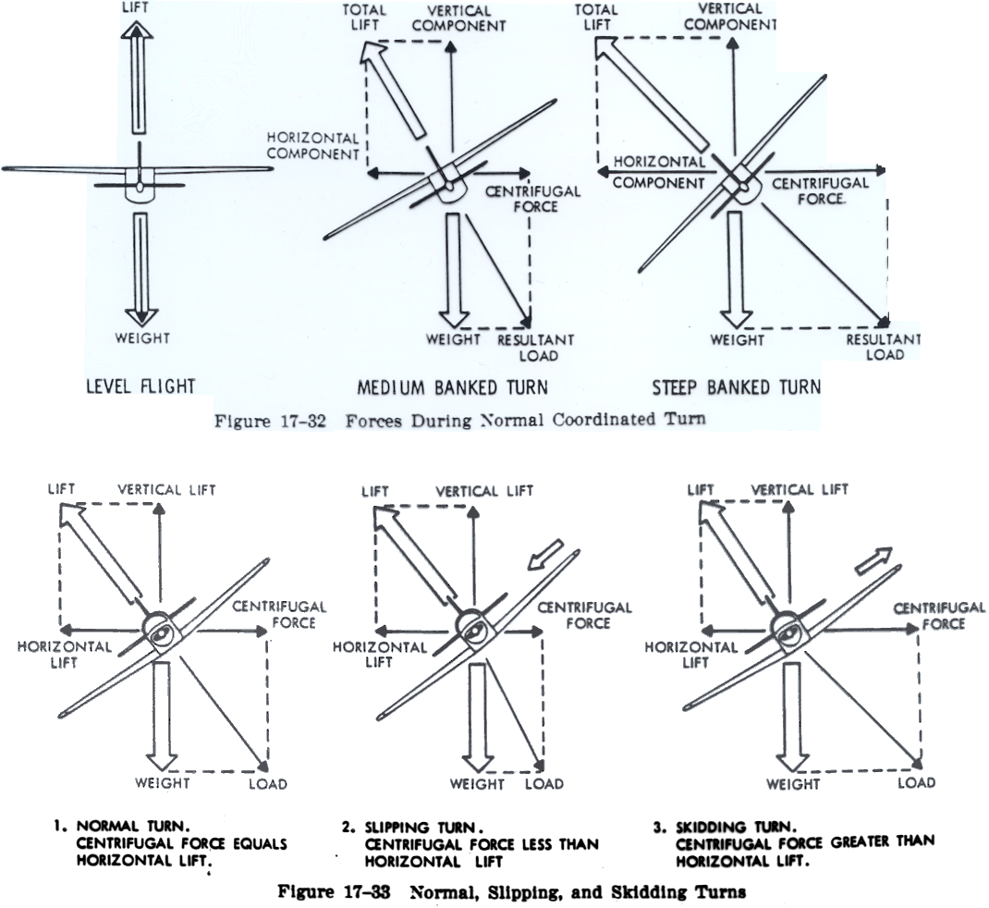
Forces in the Turn

Slide 49
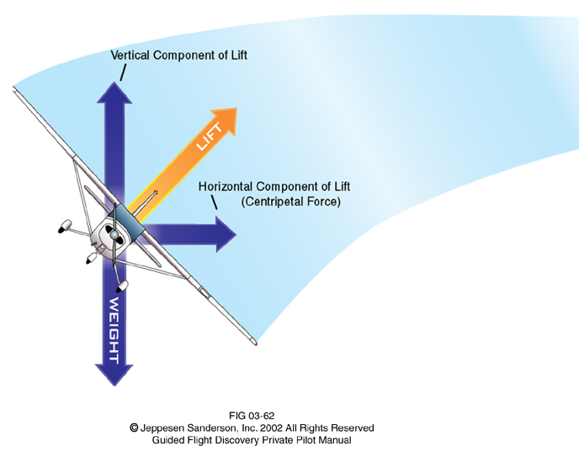
Forces In A Turn
Turns increases load factor or g’s
Higher stall speed with increase in load factor
Load factor squares as the stall speed doubles
√LF x 57 = new stall speed 2gs 60 degrees bank stalls at 80.6 knots

Slide 50
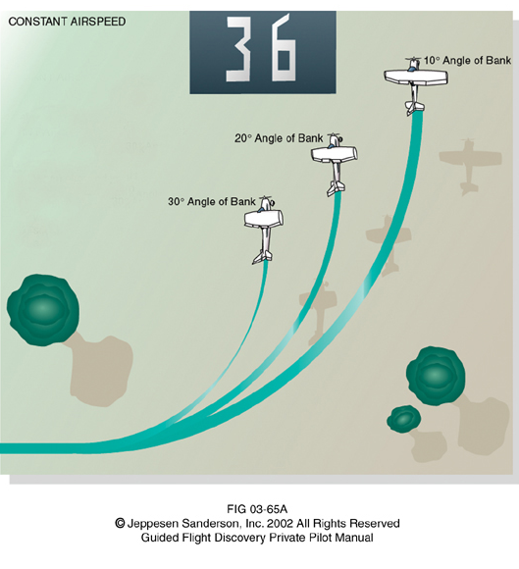
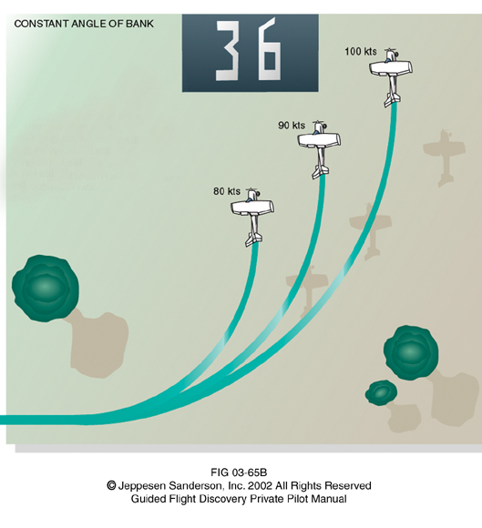
Rate and Radius of Turn

Slide 51
Unexpected Stall
Let’s take a closer look at this stall/bank angle thing for the Bonanza
No flaps stall speed of 64
Upwind to crosswind turn bank angle of 40°
Climbing at Vx 77 knots
47° is roughly equal to 1.466gs (1/cosΦ)
Poof! Stall spin die
You should run this equation on every plane you fly so you know what the envelope looks like

Slide 52
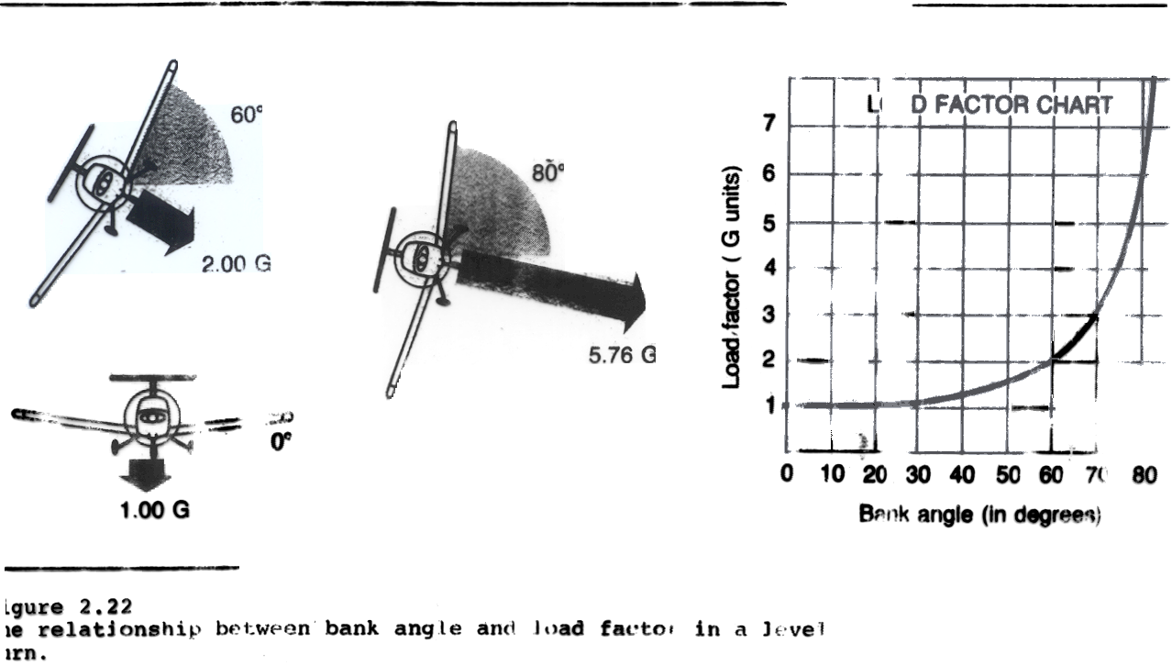
Load Factor Vs Bank Angle

Slide 53
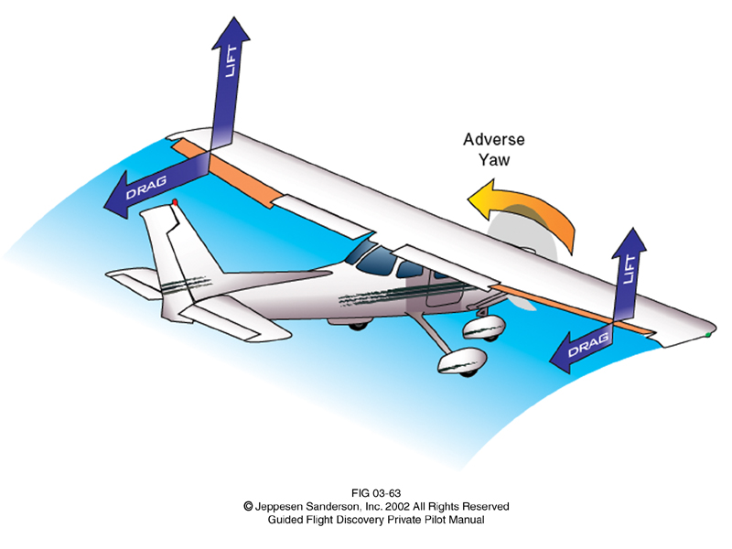
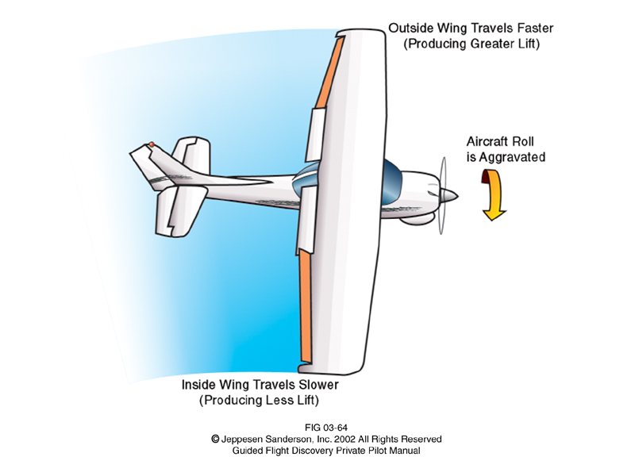
Other Turning Considerations
Adverse yaw
Over banking tendency

Slide 54
The Prop
For a prop plane the greatest thrust is full power, not moving
Referred to as static condition or static rpm
As airspeed is increased, thrust decreases
Alpha on the prop decreases as forward speed increases
This is due to the change in relative wind

Slide 55
The Prop
Since the prop is a rotating airfoil, it is subject to all the same conditions as wing
Geometric pitch is the distance covered if the prop moved through a medium like jello with no slippage
Effective pitch is the actual distance the prop covers in the air, accounts for slippage
We will cover more about props during systems

Slide 56
The 4 left turning forces
Torque
Action of the engine/prop turning clockwise causes a counterclockwise turn or left bank
Slipstream
Rotational velocity imparted by the prop forces the tail right
Gyroscopic Precession
Force is felt 90° in the direction of rotation
P-Factor
Thrust on the downward blade is more than on the upward blade

